Slide 1

Optimization Algorithms
Mini-batch
gradient descent
deeplearning.ai

Slide 2
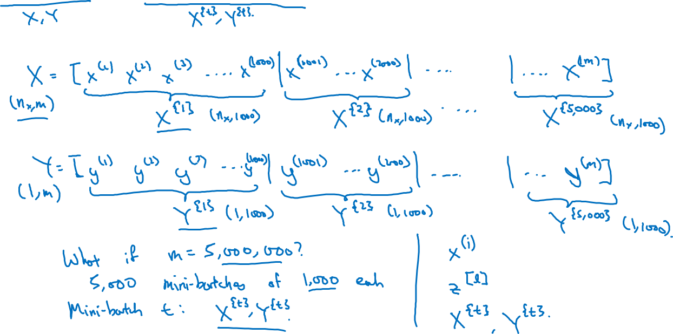
Batch vs. mini-batch gradient descent
Vectorization allows you to efficiently compute on m examples.

Slide 3
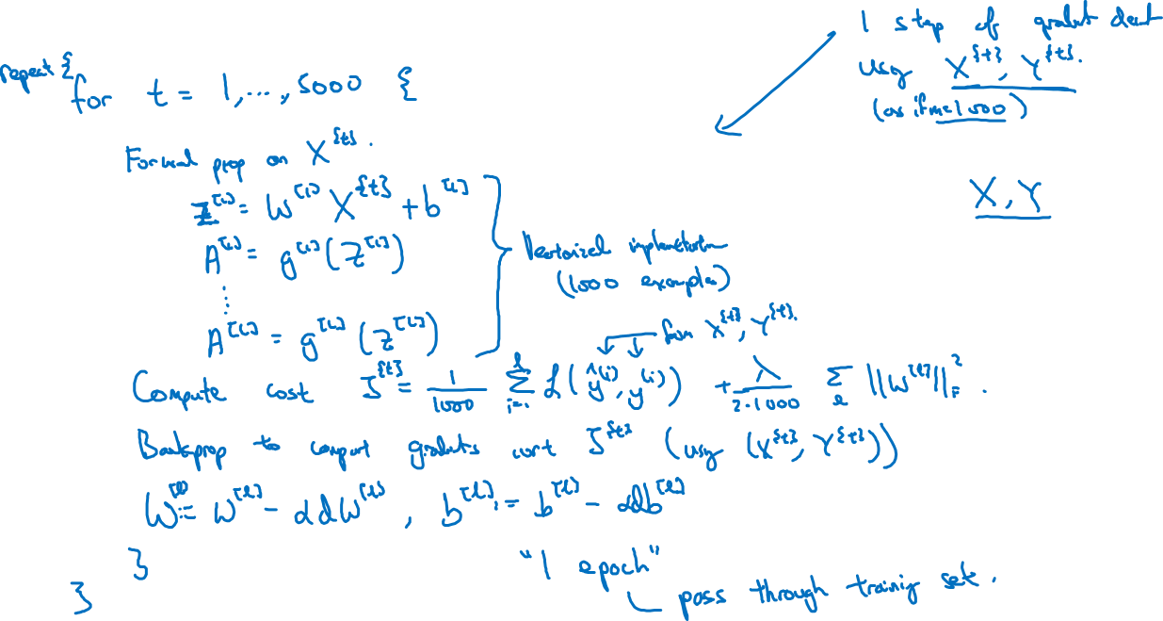
Mini-batch gradient descent

